Slide 1
Mental Skills Training for
Combat Sports
By Erin Herle

Slide 2
TABLE OF CONTENTS
01
06
ATHLETIC IDENTITY
FOCUS & CONCENTRATION
02
07
CREATING PERFORMANCE ROUTINES
IMAGERY & VISUALIZATION
03
08
SELF-TALK
PERFORMANCE STATES
04
09
GOAL SETTING/IMPLEMENTATION
HANDLING ERRORS & SETBACKS
05
10
MENTAL TOUGHNESS
TECH & TOOLS FOR MST

Slide 3
01
ATHLETIC IDENTITY
WHAT IS IT?
HEALTHY VS UNHEALTHY
WHY IS IT IMPORTANT?
The degree to which a person identifies with their athletic role.
Sport requires sacrifice but how much is too much? Healthy athletic roles share a balance with other life roles while unhealthy leads to burnout and overtraining.
It is the foundation of an athlete’s self-concept and much of their feelings, thoughts, and behaviors are influenced by it.
(Giannone et al., 2017)

Slide 4
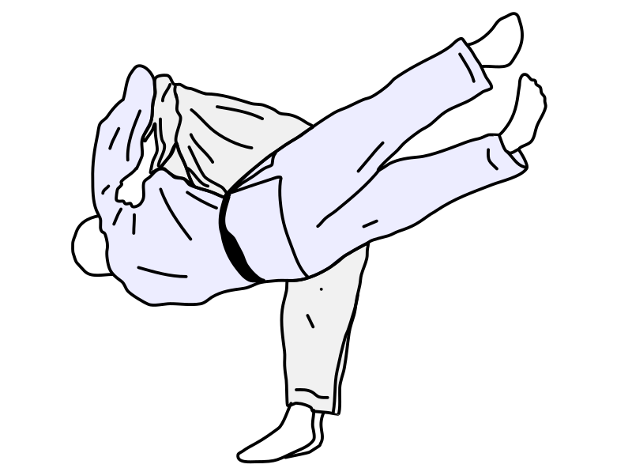
02
CREATING
PERFORMANCE ROUTINES
BENEFITS OF ROUTINES
TYPES OF ROUTINES
PRACTICE, PRACTICE, PRACTICE
Routines provide stability and familiarity despite changing environments. We do not simply show up; we arrive!
Prepare for the what-if situations by creating Plan A, Plan B, Plan C routines that are repeatable, purposeful, consistent, yet flexible.
Increase benefits by learning and practicing the skills of each routine. Repetition and sparring to gain new skills is already part of your arsenal!
(Hazell et al., 2014)

Slide 5
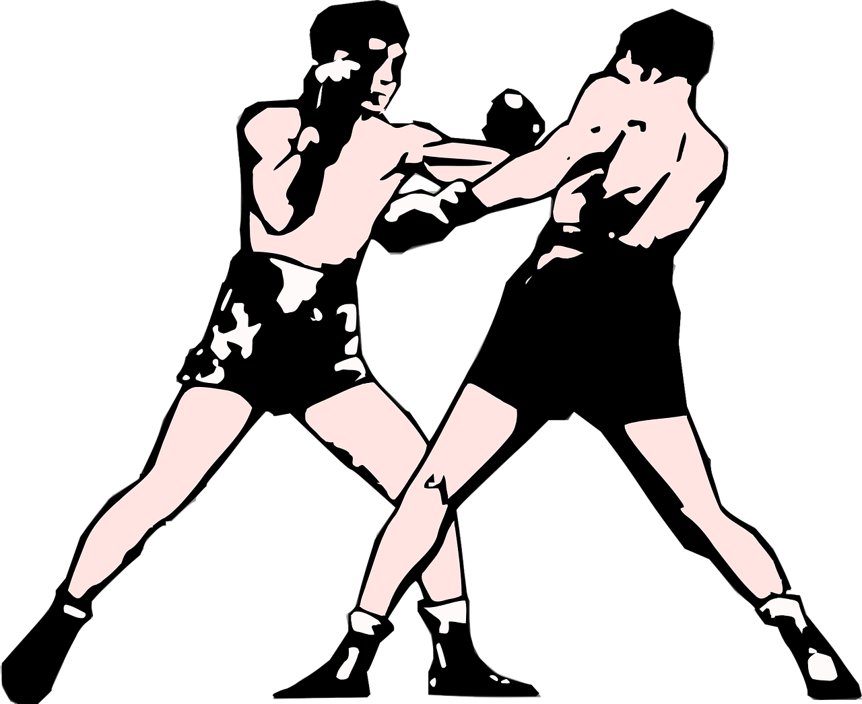
03
SELF-TALK
YOU ALREADY DO IT
TYPES OF SELF-TALK
TURNING NEGATIVE INTO POSITIVE
What you say to yourself matters and can be used to mediate your response to a situation
Motivational: when you need more effort or energy “You can do this” or “If I sweep, I win” | Instructional: cues for when you execute a task “Chin down” or “Sprawl!”
Negative: focuses on what you do wrong/inner critic “You suck” or “You’re so stupid for tapping” | Neutral: distracting thoughts and useless info “I want spaghetti” or “I have to call my mom later”
Thought stopping, ironic processes, reframing are all things to be aware of.
(Weinberg & Gould, 2019)

Slide 6
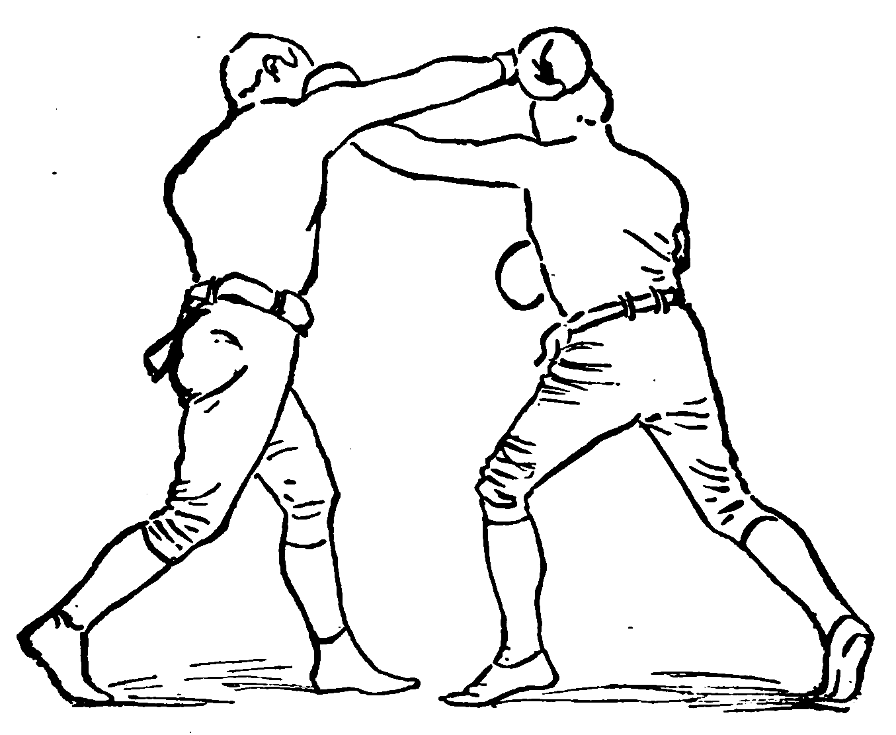
04
GOAL SETTING & IMPLEMENTATION
STRATEGIES FOR SUCCESS
TYPES OF GOALS
HOW?
Define what you want to do, how you’ll get there, when you will use them, why you want to achieve it.
From least controllable to controllable: outcome goals (win or lose), performance goals (get a takedown in fight), process goals (drill a technique)
SMARTS: Specific, Measurable, Action-Oriented, Realistic, Timely, Self-Determined Set 1 or 2 at a time, don’t be afraid to adjust them, use your support system for commitment.
(Weinberg & Gould, 2019)

Slide 7
05
MENTAL TOUGHNESS
TOUGH TO DESCRIBE
THE 4 C’S
PRACTICE FAILURE
Striving for excellence despite adversity is a common definition but what does that look like?
Control: focus on what you can control like your thoughts and positive self-talk | Challenge: appraise situation as a challenge, not a threat like fighting again after a loss
Commitment: your dedication to the pursuit of excellence like giving up comfort for growth | Confidence: believing in yourself after failure like believing you will achieve your dream
Build your mental toughness by exposing yourself to challenging situations in practice and developing a mental rehearsal routine for when things don’t go as planned
(Weinberg & Gould, 2019)

Slide 8
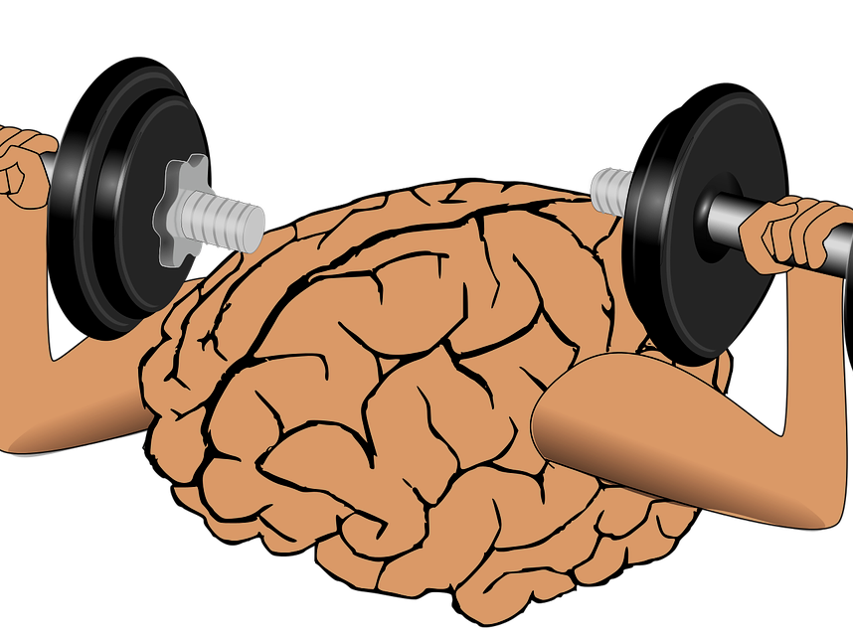
06
FOCUS &
CONCENTRATION
ATTENTION VS FOCUS VS CONCENTRATION
TYPES OF ATTENTIONAL FOCUS
PERFORMANCE LOOP
Attention= broad awareness of surroundings. Focus= narrow awareness. Concentration= one specific cue
Broad: ability to take in multiple cues by scanning your environment | Internal: focusing on your thoughts and bodily reactions like heart rate or self-talk
Narrow: honing in on one or two cues like when you pass a guard or fight in the clinch | External: focusing on things outside of your body like your opponent’s moves or cheers in the crowd
Constant scanning & information-processing is called visual-perceptual-cognitive-information processing-anticipation-decision making-reaction time-feedback loop
(Keegan, 2014)

Slide 9
07
IMAGERY & VISUALIZATION
WHY USE IMAGERY?
EFFECTIVE IMAGES
THEORIES BEHIND IMAGERY
Imagery allows you to simulate situations in your mind to enhance your planning, skills, and motivation
Modality: Are you using all five senses? Perspective: do you see yourself on a movie screen or from your own point-of-view? Angle: What direction are you viewing yourself? Someone else? Deliberation: Is this a deliberately designed image or spontaneous? Agency: Who is directing the image? You or is someone guiding you?
Psychoneuromuscular theory, symbolic learning theory, bioinformational theory, triple code theory
(Burton & Raedeke, 2008)

Slide 10
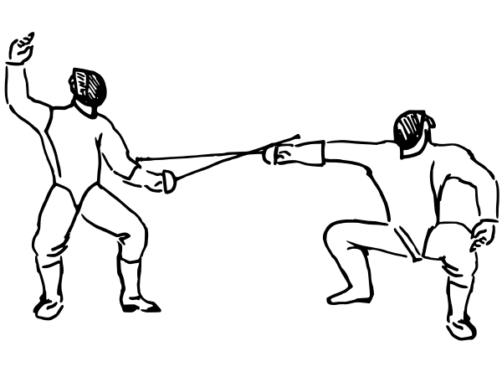
08
PERFORMANCE STATES
AROUSAL VS ANXIETY
TYPES OF ANXIETY & STRESS
RELATIONSHIP BETWEEN AROUSAL AND PERFORMANCE
Arousal is the amount of activation to perform a task. Anxiety is the negative emotion like worry & apprehension.
Cognitive: the mental aspect like intrusive thoughts | Somatic: the physical aspect like sweating/heart rate
Trait: part of your personality as a predisposition | State: ever-changing in relation to stressors
Situational stressor: importance of the event or uncertainty of the outcome | Personal stressor: presence of trait anxiety, self-esteem, social anxiety
(Burton & Raedeke, 2008)
Drive theory, Inverted-U hypothesis, IZOF, Reversal theory, Multidimensional Anxiety Theory, Catastrophe model

Slide 11
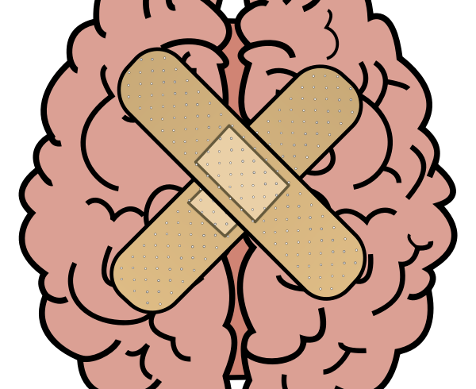
09
HANDLING ERRORS & SETBACKS
GET COMFORTABLE WITH THE UNCOMFORTABLE
GUIDELINES FOR MANAGING ERRORS
BUILD PERSONALIZED ROUTINES FOR ERRORS
Errors are prevalent in any sport so how we cope with them determines whether we learn from our mistakes.
Be in the moment and present instead of replaying errors or anticipating future events. Recognize the warning signs of tension so you can manage it before it becomes a problem. Have fun because if you don’t enjoy what you do then you might increase anxiety or focus on outcomes. Come with a good game plan by strategizing with Plan A, Plan B, Plan C routines. Don’t rush because haste makes waste.
Some things you can add are: diaphragmatic breathing, symbolic reset after an error, positive/instructional self talk, cognitive reappraisal, strategy planning, arousal management techniques.
(Weinberg & Gould, 2019)

Slide 12
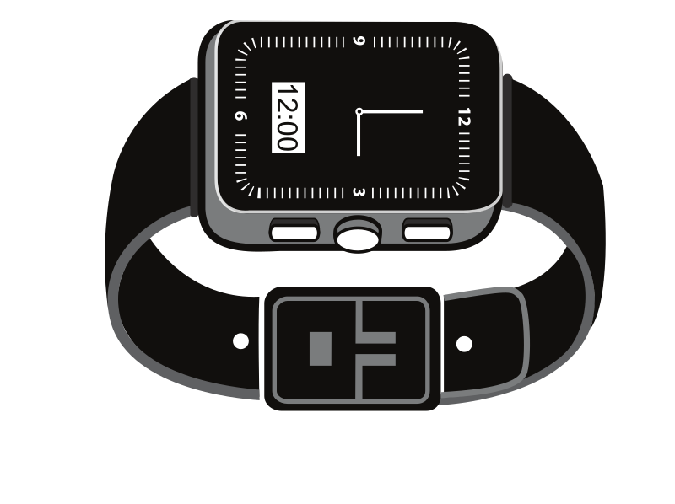
10
TECHNOLOGY & TOOLS
BE A CRITIC
A lot of technology is available to aid in your mental skills training so be critical of whether it can really help your performance
Would the promised information be helpful? Decide what you want to measure and research whether the technology can reliably provide that data.
Can you trust the information you’ll be getting? Look for independent peer-reviewed studies that can prove validity.
Can you integrate, manage, and analyze the data effectively? As a consumer you have limited knowledge of data evaluation but trusting a product often means trusting its data.
Can you implement the technology into your practice? Consider the time and resources required to use the technology and how that interferes with your current routine.
(Windt et al., 2020)

Slide 13
ANY QUESTIONS, CONCERNS, OR COMMENTS?

